Slide 1
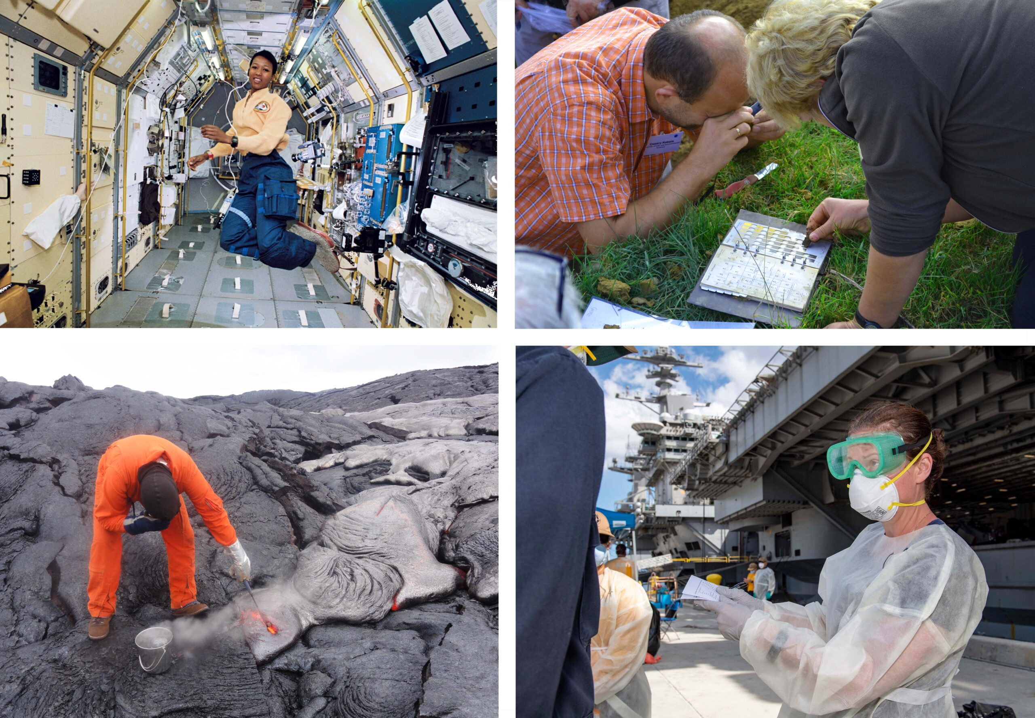
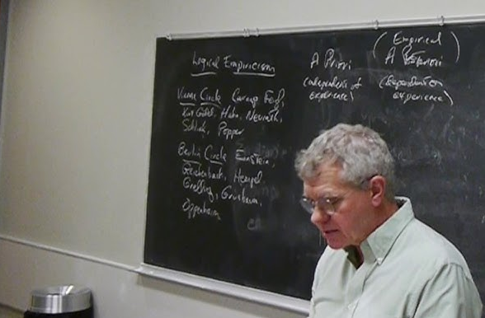

What is Science? and Logical Empiricism
TA: Luka Vinck 3 September 2026
Philosophy of Science Tutorial 1

Slide 2
Welcome!
Introduction round
Luka Vinck
l.j.vinck@uva.nl

Slide 3
Plan
Project description and planning
Discussion of texts

Slide 4
Project Description
Write a philosophical research paper on one of the topics in the course
Take an existing discussion in contemporary philosophical literature as a starting point
Groups of 1-3 persons
~4000-7000 words per person (all inclusive)

Slide 5
Course Planning
Week | Topic | Project deadlines
1 | Logical Empiricism
2 | Kuhn on Scientific Practice
3 | The Duhem-Quine Thesis | Writing workshop: come prepared with project idea
4 | Explanation and Understanding | Submitting project proposal (Friday 25 September)
5 | Scientific Realism 1 | Feedback
6 | Scientific Realism 2
7 | Laws of Nature | Presentations and submitting first draft and slides (Sunday 18 October)
8 | Exam
Final project deadline: 31 October

Slide 6
Brainstorm
Look into the topics of the course (Stanford Encyclopedia of Philosophy)
Look at the example papers on Canvas
Look at (recent) papers in philosophical journals:
  Synthese
  Studies in the History and Philosophy of Science
  European Journal for Philosophy of Science
  The British Journal for the Philosophy of Science
  Erkenntnis

Slide 7
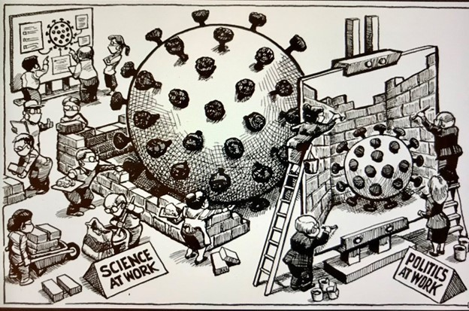
Philosophy of Science
What is science?
What is ‘good’ science?
Why and how does science ‘work’?
What does science learn us about nature?

Slide 8
Philosophy of Science
Epistemology – what can we know?
Metaphysics and Ontology – what ‘is’?
But also: Politics – what counts as truth?

Slide 9

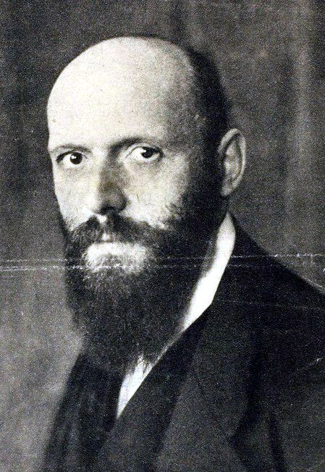
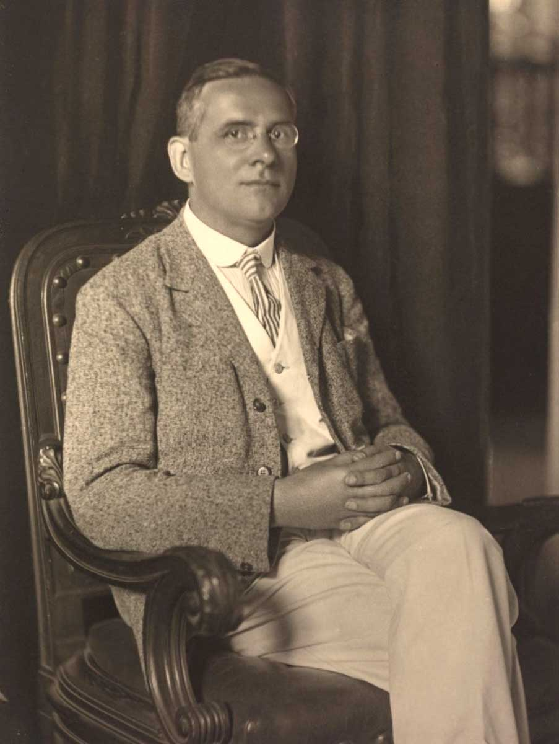
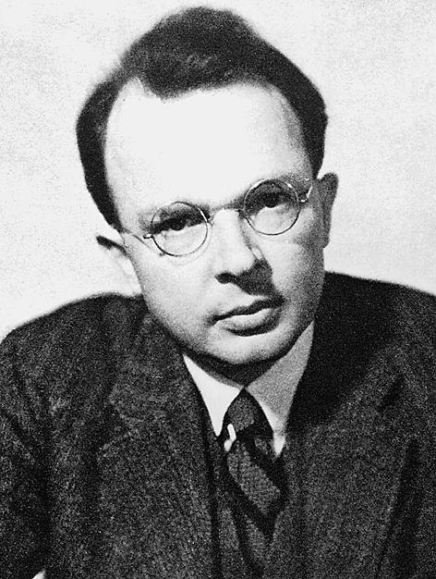
Logical Empiricism
Discuss in groups of 3-4
What were the central ideas of (early) logical positivism?
Which ideas from the philosophy of language inspired the movement?
How did these underpin their philosophy of science?

Slide 10
Logical Empiricism
Question:
What is science according to the logical positivists?

Slide 11
Carnap – The Elimination of Metaphysics
Discuss in groups of 3-4
What was Carnap’s critique of ‘metaphysics’?
What central idea of logical positivism does Carnap use in his critique?
Do you agree with his critique, why yes or no?

Slide 12
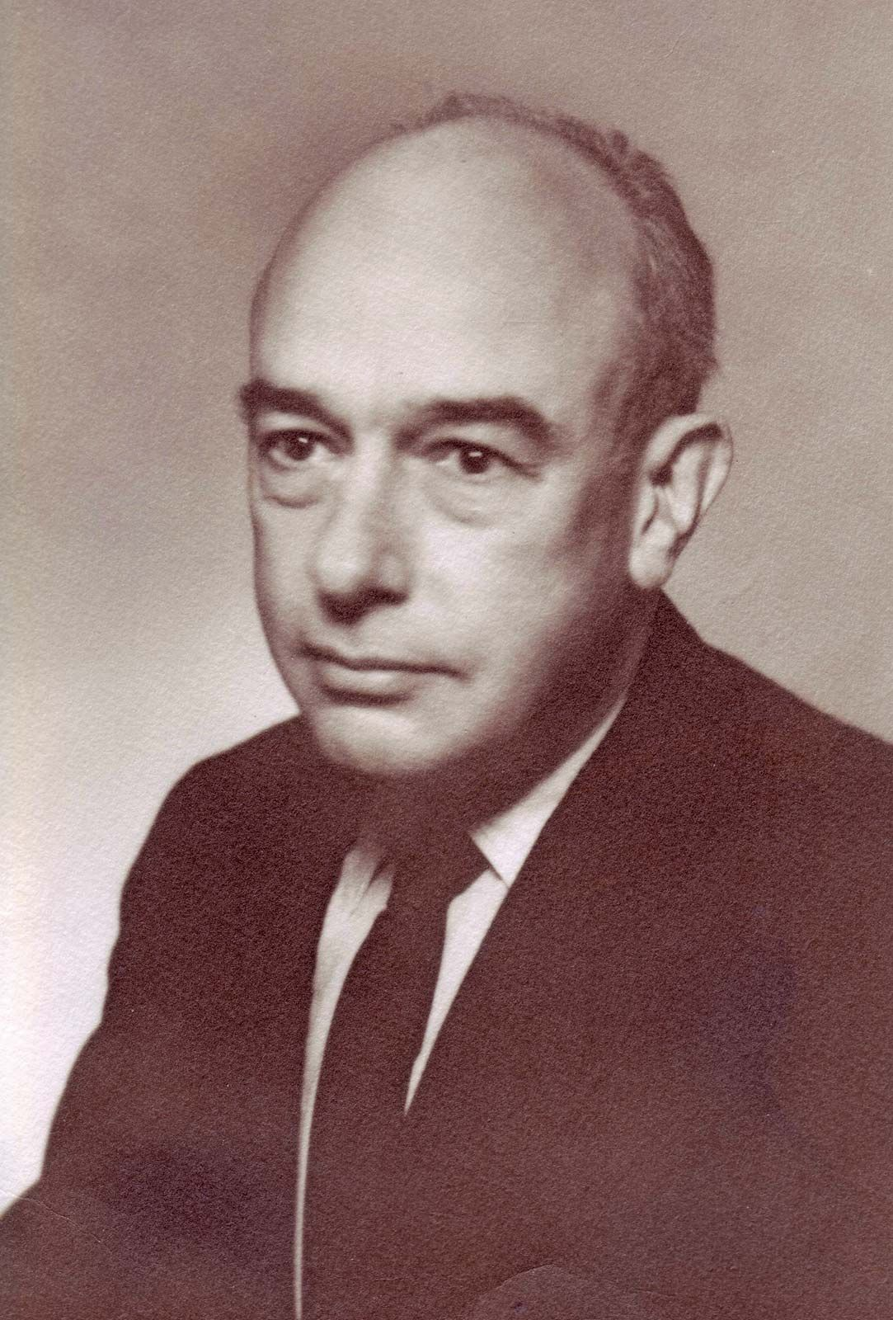
Logical Empiricism
Discuss in groups of 3-4
How was the early logical positivist program challenged?
By internal problems?
By external critique?

Slide 13
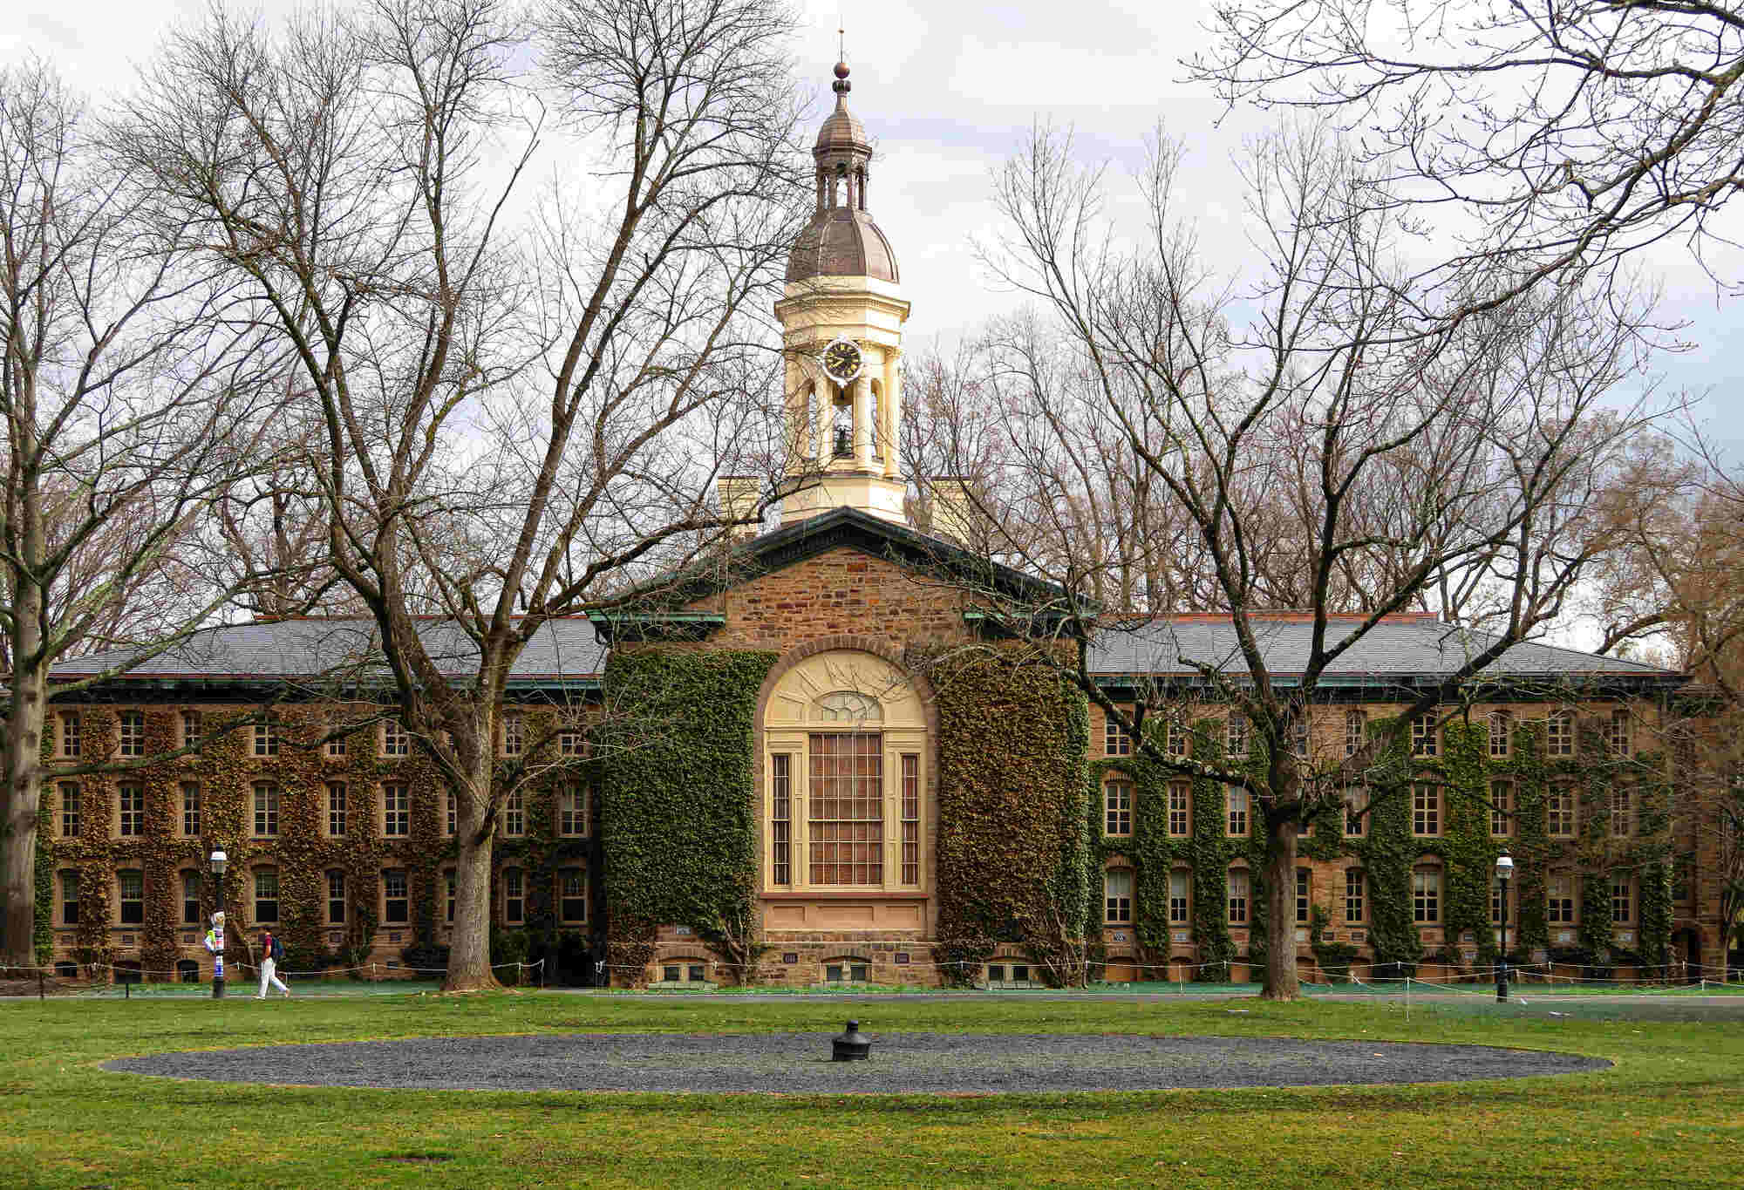
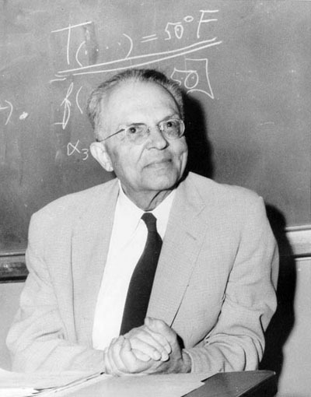
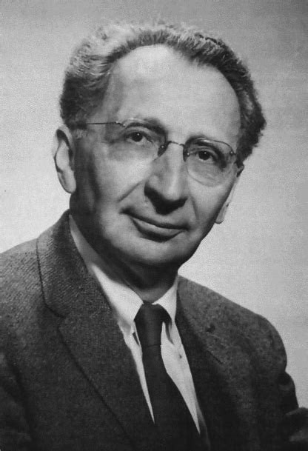
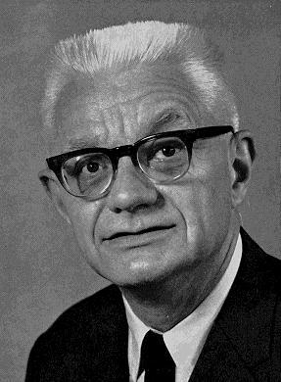
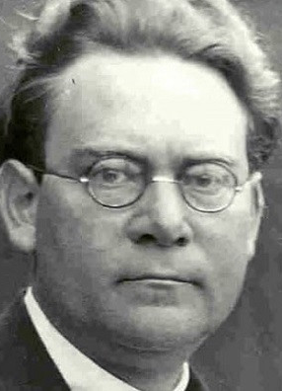
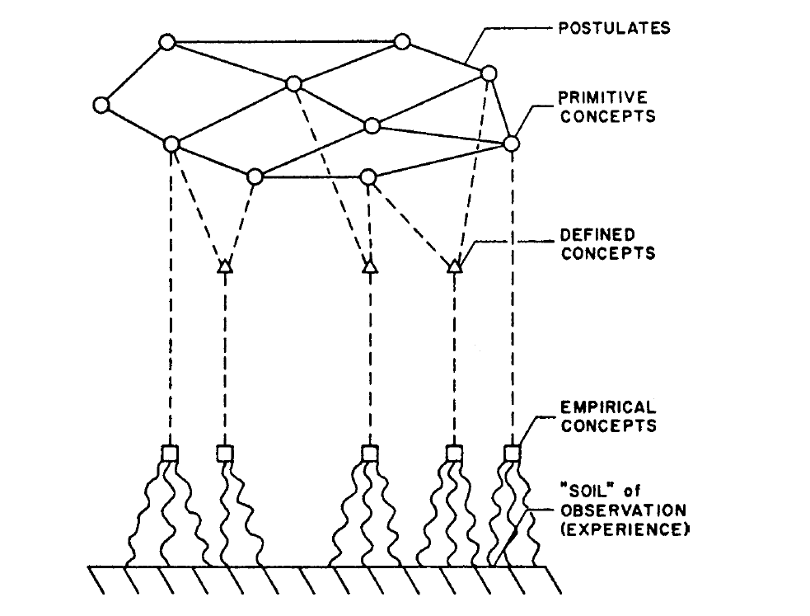
Logical Empiricism
Question:
How did the later logical empiricism differ from early logical positivism?

Slide 14
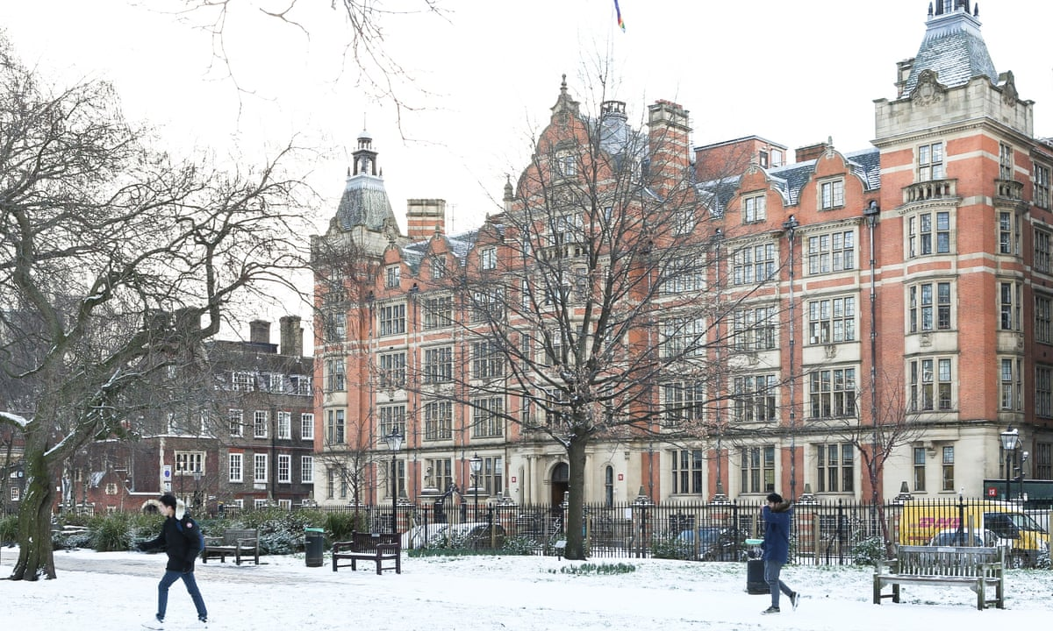
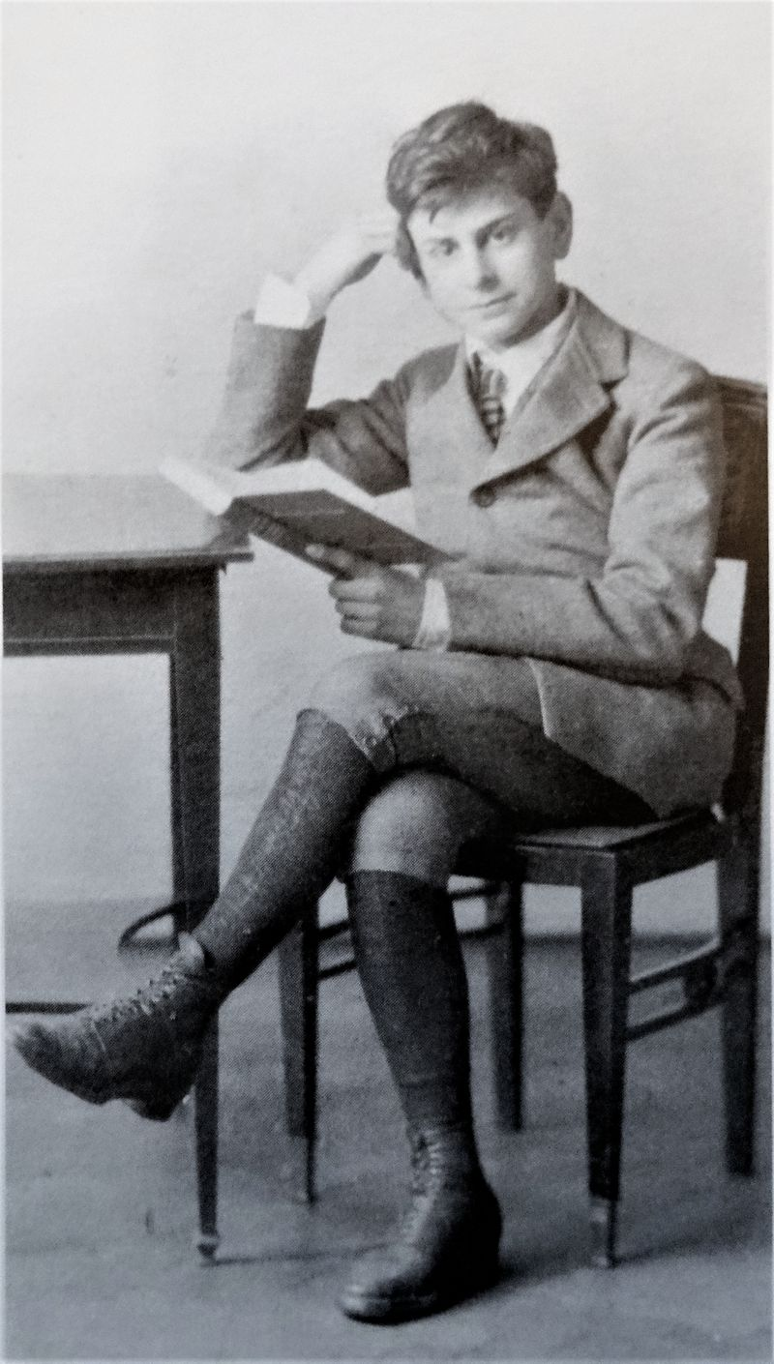
Popper – Science: Conjectures and Refutations
What makes a theory ‘scientific’?
Discuss in groups of 3-4
What is Popper’s answer to this question?
What characterises ‘pseudo-science’?
What characterises true science?
Question
How does Popper’s criterion of falsifiability relate to the verificationism of the logical positivists?
Are these different or actually the same thing? And which one do you think is more accurate?

Slide 15
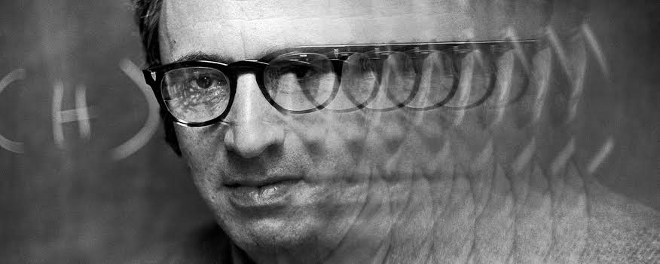
Next week
Kuhn on Scientific Practice
Questions?

